Slide 1
Main) +20.2.25179854│(Fax) +20.2.25179389
Sales@petronebra.com
info@petronebra.com
www.petronebra.com

Slide 2
1
INTRODUCTION
2
BACKGROUND
3
OUR MISSION AND VISSION
4
SCOPE OF WORK
5
PARTENERS AND PRODUCTS
6
Our free zone and facility
7
ORGANIZATION CHART
8
HSE POLICY
9
CONTACT US

Slide 3
INTRODUCTION
- We help you to build and maintain a more profitable well. Using exclusive Well-construction technologies and flawless service execution, we set the Stage for life-of-well integrity and prolific production. Then we unleash the Full potential of your assets with integrated intervention and production-Optimization solutions.
- PetroNebra Oilfield Services is established to provide a broad range of Services and products to North Africa oil industry through there eminent Steady principles and affiliate companies
-Founded 2016
-Multi line services for oil and gas field
-Serve North Africa Region with headquarter in Cairo, Egypt. With extensive experience and business network contacts; regionally and
Locally, PetroNebra is committed to share the success with their customers by Providing quality products and services. The synergy between knowledge, Experience and qualified team members will result in high quality Performance That will meet or exceed customers’ standards and expectations.
-PetroNebra strives to excel and become the customer’s preferred supplier by Providing engineered solutions that fit their needs in a cost efficient way. Our Objective is to perform high quality work in a safe manner.

Slide 4

BACKGROUND
PetroNebra is dedicated to providing products that lead the oil And gas industry with safety and the environment in mind, while operating Our business for the benefit and wellbeing of the general public, countries Where we work, our employees and customers. To sustain this commitment, PetroNebra manages HSE under a Health, Safety, and Environmental Management System (HSE MS) model.

Slide 5
OUR MISSION AND VISSION
PetroNebra mission
- Build a Profitable & Sustainable Business with Discipline Growth and Diverted Portfolio with our Business Partners to be Oil & Gas Services Company of “Choice” in the North Africa Region Capturing a Higher Market Share by realizing market trends & Customer Developments
-We work close with our customers and, as a result, we provide them with quality and innovative Solutions. Through these relationships we give our affiliates a strong foundation for regional growth and market expansion, and create value for our customers, suppliers and our company’s stakeholders.
PetroNebra Vision
-Through high quality and efficient comprehensive services, we aim to be the preferred strategic partner for our customers and international companies in Egypt and Middle East markets.

Slide 6
SCOPE OF WORK
Our Company is dedicated to providing a wide range of quality products to supply and service the global oilfield market. We offer quality
products with competitive pricing to meet the needs of our customers in a timely manner.
Our products and services include:
Well head Services.
Pressure Control Equipment.
Liner Hanger Systems & Casing accessories.
Welding.
Down Hole Completion.
Rental Tools.

Slide 7
PARTENERS AND PRODUCTS PARTENERS AMROC BREMSE, are API, ISO 9001, 14001, 18001 certified manufacturer of Cementing products in the Globe offering a complete solution of both welded and non welded Centralizers, Float Equipment's, Stop Collars, Bridge Plugs and other Cementing equipment's for Oil and Gas Drilling Industries over years. We at AMROC have professional team of skilled engineers equipped with world’s advanced technology to deliver supreme quality casing and cementing equipment's essential for Oil & Gas sector. We have ventured into the field of oil tools with innovative solutions, high quality products on time, designed through special machines to cater customer requirements

Slide 8

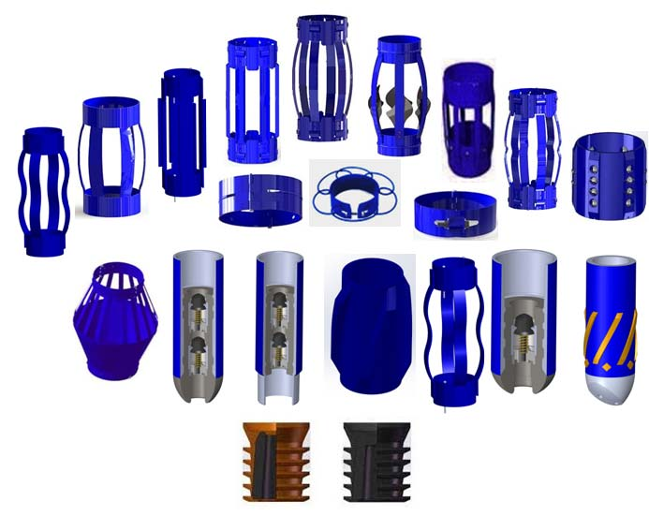
- Casing Accessories

Slide 9
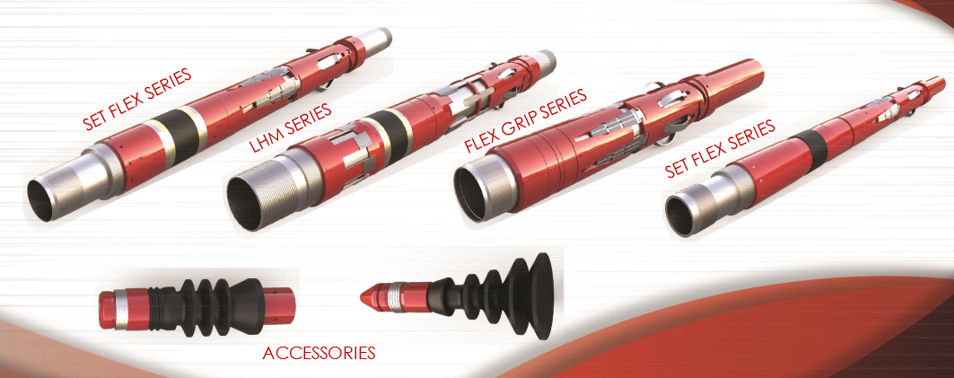
- Liner Hanger Systems.

Slide 10
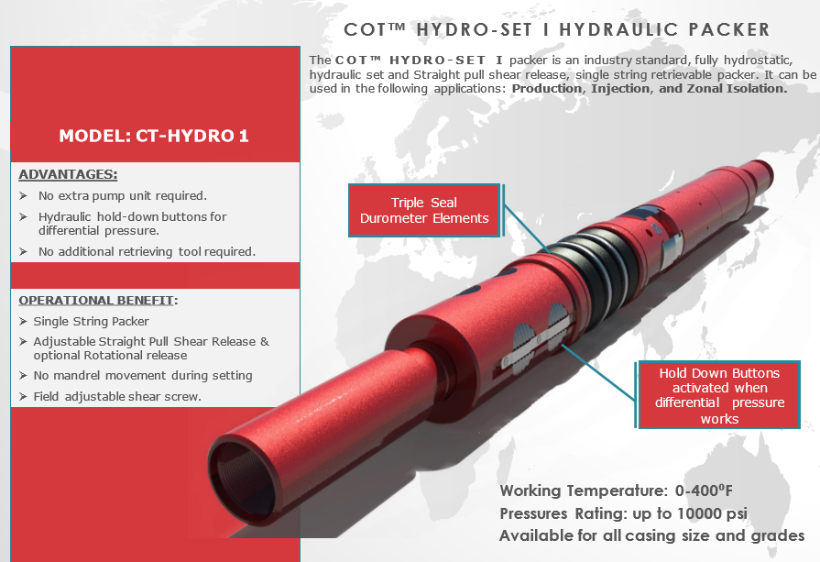
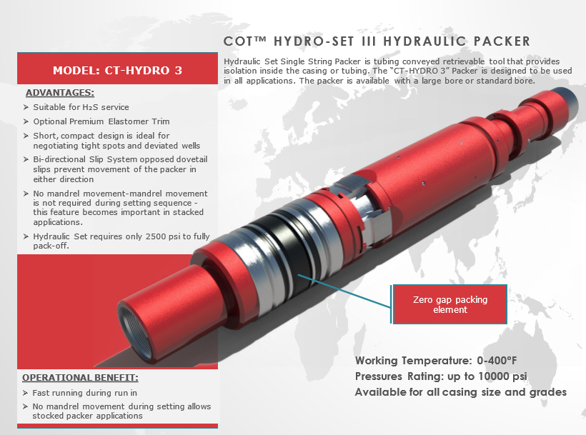
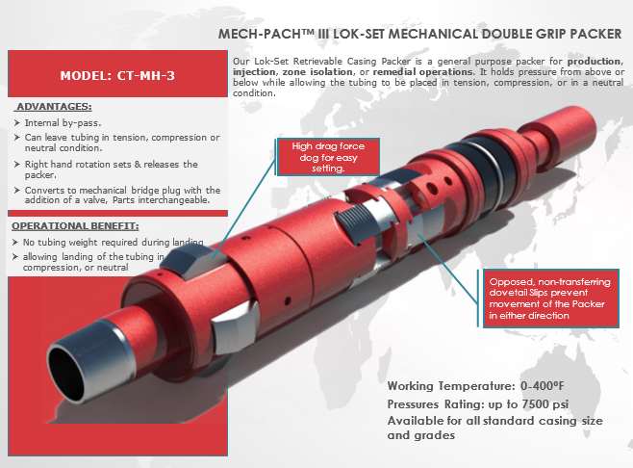
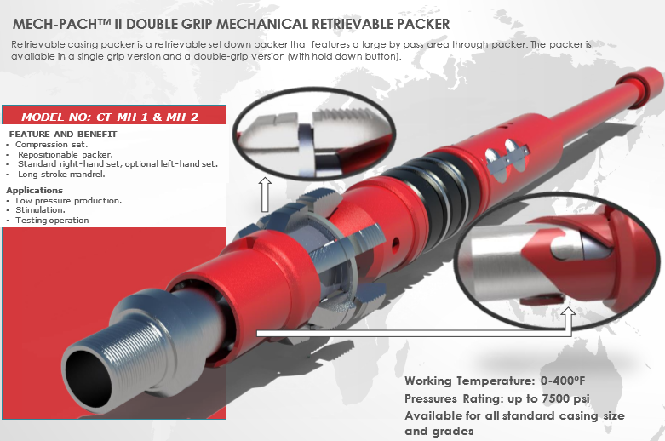
- Down Hole Completion.

Slide 11
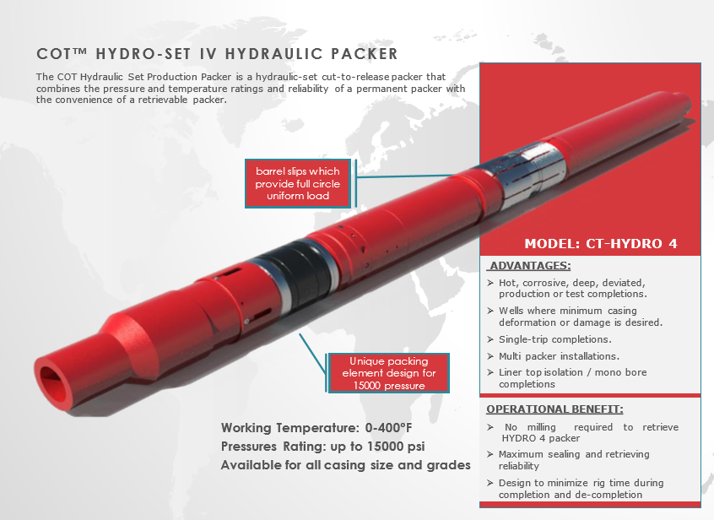
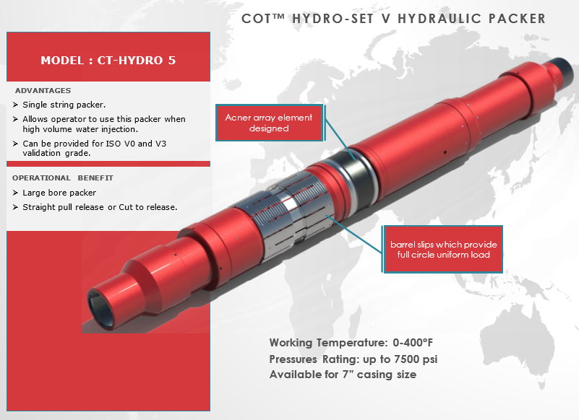

Slide 12
- Rental Tools and machine shop
Premium & API Tubular Threading & repair
Casing & Tubular Accessories
Repair of various drilling tools, threading, and fabrication.
Repair, maintenance and supply of drilling and oilfield equipment
Repair of hooks, swivels, hydraulic tongs and BOPs, etc.
Overhaul and maintenance of various engines.
Rental Non-Magnetic Drill collar
API Flanges and Spool
Casing and tubing hangers
Drilling and production chokes
Studded and flanged tees and crosses
Crossover connections

Slide 13
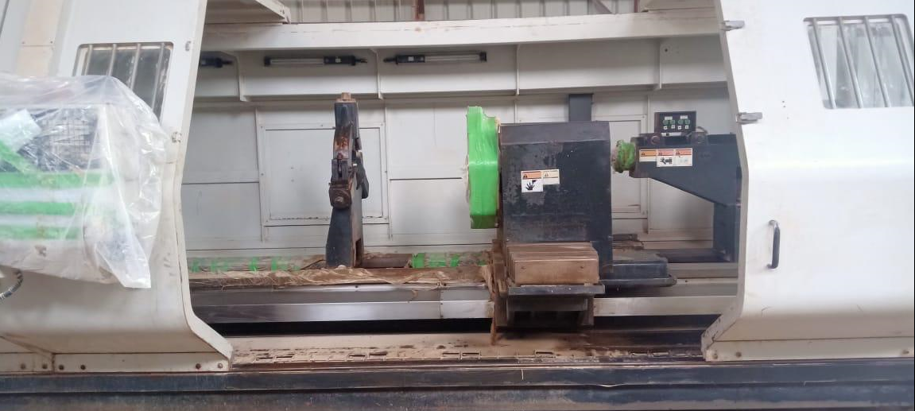
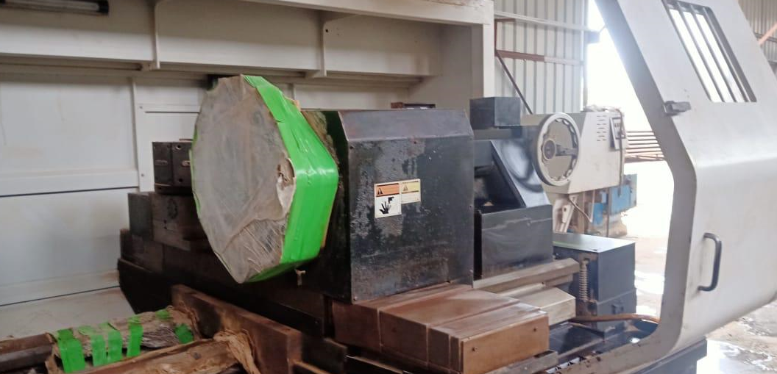
Our Free zone and Facility

Slide 14
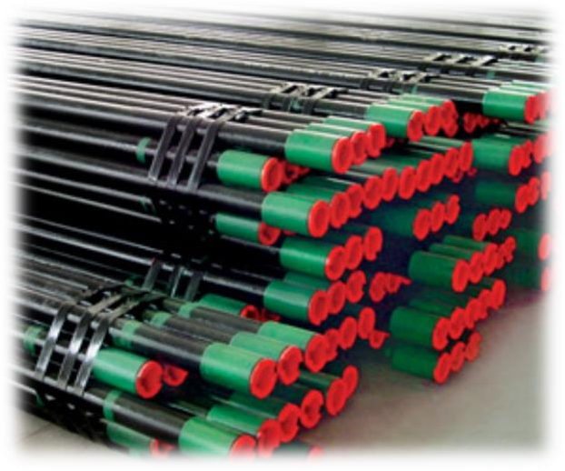
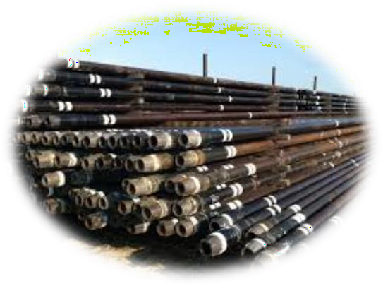
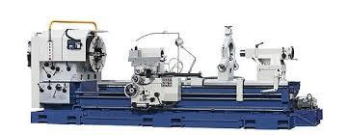
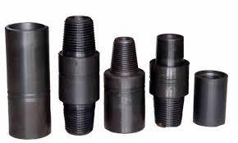
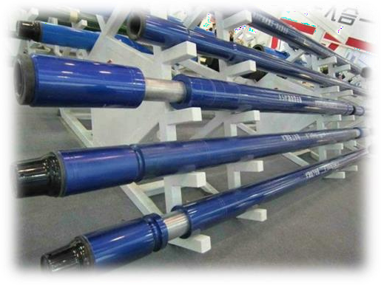
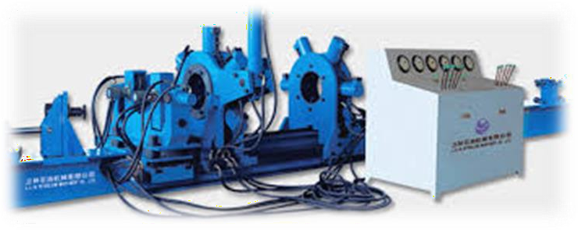
- Rental Tools

Slide 15
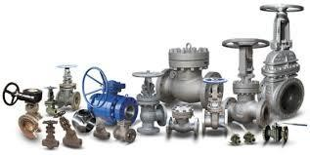
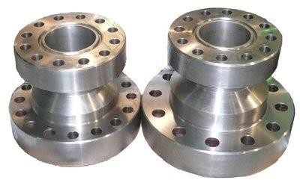
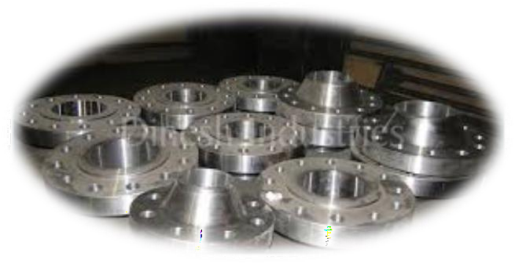
Our PRODUCTS - Well head Services

Slide 16
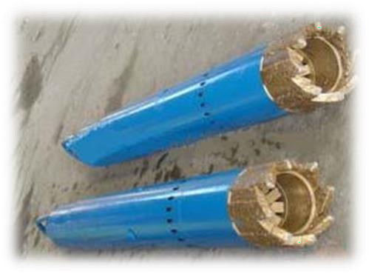
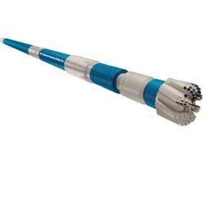
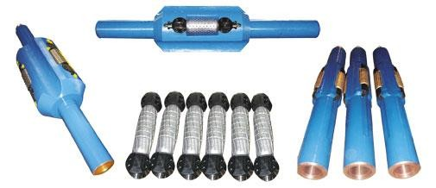

Slide 17
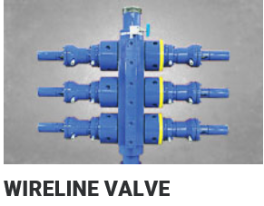
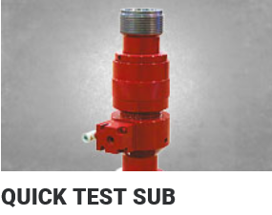
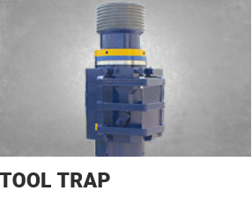
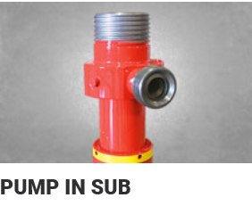
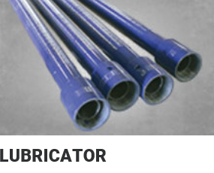
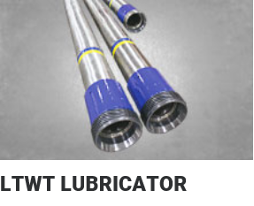
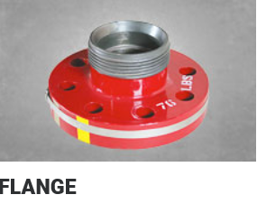
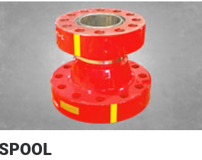
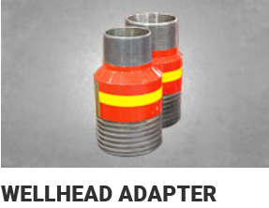
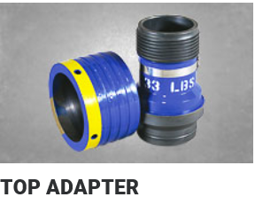
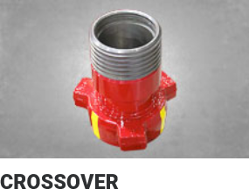
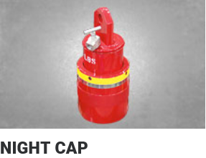
- Pressure Control Equipment

Slide 18
- Welding
Shielded Metal Arc Welding (SMAW)
Tungsten Inert Gas Welding (TIG)
Dressing of Tungsten carbide hard facing
Large diameter connector and wellhead welding
Modifications of rock bits
Repair ,redress and grinding of stabilizers
Others complex welding processes
Our welding services are performed to the industry approved welding specifications. We ensure the quality of our work by 100% Non- Destructive Testing (NDT) via radiographic testing, MPI, dye penetration, etc.

Slide 19
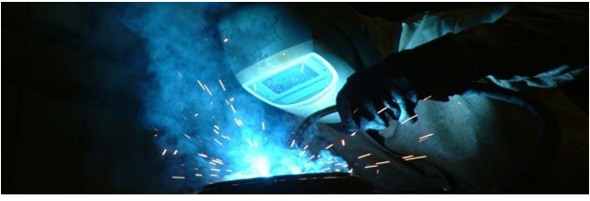
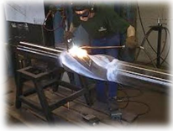
- Welding.

Slide 20
- ORGANIZATION CHART
Ahmed Ateya Managing Director
Mohamed Elkhouly
Technical Support
Samah Awny
Finance Manager
Hany Fouad
Supply Chain Manager
Arafa El Tayeb
Base Manager
Islam Abd Elsalam
Operations Engineer
Abdelaleem A.Salam
Workshop Supervisor

Slide 21
HSE POLICY -Processes established and maintained are to ensure relevant requirements of PetroNebra HSE MS are met for activities, products, or services for which it Is expected PetroNebra has reasonable control or influence. This includes Those activities, -products or services performed by employees, contractor or third parties on PetroNebra behalf that can affect the performance of HSE MS. -Every supporting operational control is to be maintained in accordance with This HSE MS as appropriate. Business Segment and/or Business Unit HSE MS must include at least the following operational controls: - Hazard Identification, Risk Assessment, and Controls. - Environmental Aspects and Impacts. - Legal and Other Requirements. - Objectives and Targets. - Management of Change. - Roles, Responsibilities, and Authorities. - Competence, Training, and Awareness. - Communication, Participation, and Consultation. - Operational Planning and Control. - Emergency Preparedness and Response. - Documented Information.

Slide 22

- Monitoring, Measurement, Analysis, and Evaluation. - Internal Audits and Assessments. - Evaluation of Compliance. - Control of Records. - Incidents, Nonconformity, Corrective and Preventive Action. - Management Review; and Continual Improvement.

Slide 23

CONTACT US Ahmed Ateya Chairman & Managing Director PetroNebra Oilfield Services Free Zone Cell: +201000446664, +201200936000 e-mail: ahmed.ateya@petronebra.com Mohamed Elkhouly technical support supervisor PetroNebra Oilfield Services Free Zone Cell: +201202801010 e-mail: Mohamed.elkhouly@petronebra.com

